Slide 1
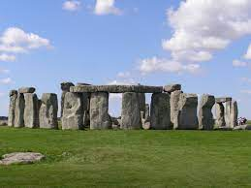
ELIT214 BRITISH CULTURAL HISTORY
Week-2

Slide 2
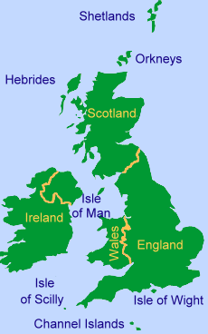
The Influence of Geography
«Britain is an island, and Britain's history has been closely connected with the sea. […] Britain’s history and its strong national sense have been shaped by the sea.» (p.3)

Slide 3
Prehistory of Britain
It refer to a time in a people’s history before they used a written language. In Britain the term Prehistory refers to the period before Britain became part of the Roman empire in AD 43.

Slide 4
The Paleolithic Age in Britain
The Old Stone Age: The very first men of all are called Eolithic, from a Greek word meaning “early stone.”
Coming from Iberian (Spanish) peninsula, Those people were small, dark, and long-headed people and they are though to be forefathers of dark-haired inhabitants of Wales and Cornwall.
Palæolithic (Old Stone Age) men came after them.

Slide 5
The Paleolithic Age
The Paleolithic Age, also known as the Old Stone Age, is a period of prehistory that lasted from about 2.6 million years ago to around 10,000 years ago.
During this time, Britain was inhabited by early humans known as Homo sapiens, who were hunter-gatherers. They lived nomadic lifestyles, moving from place to place in search of food, water, and shelter.
These early inhabitants of Britain relied on hunting animals for meat and gathering wild plants for food. They used simple stone tools, such as handaxes and scrapers, which they made by chipping away at rocks.
The climate during the Paleolithic Age in Britain was much colder than it is today, with glaciers covering much of the land. Despite the harsh conditions, early humans adapted to their environment and survived.
Evidence of Paleolithic settlements in Britain includes cave paintings, stone tools, and animal bones found at archaeological sites such as Creswell Crags in Derbyshire and Paviland Cave in Wales.
The Paleolithic Age laid the foundation for human settlement and cultural development in Britain. It marked the beginning of human occupation of the British Isles and the gradual transition from nomadic hunting and gathering to more settled lifestyles in later periods.

Slide 6
The New Stone Age
(the Neolithic)
Men began to progress rapidly in civilisation. This more civilised period is called the Neolithic.
They made their stone weapons and tools much more skilfully.
They built their huts together in villages.

Slide 7
Chalkland people and henges
Early Britons built wooden earth banks and stone circles which are called henges.
Those places were regarded as the centres of religious, political and economic power.

Slide 8
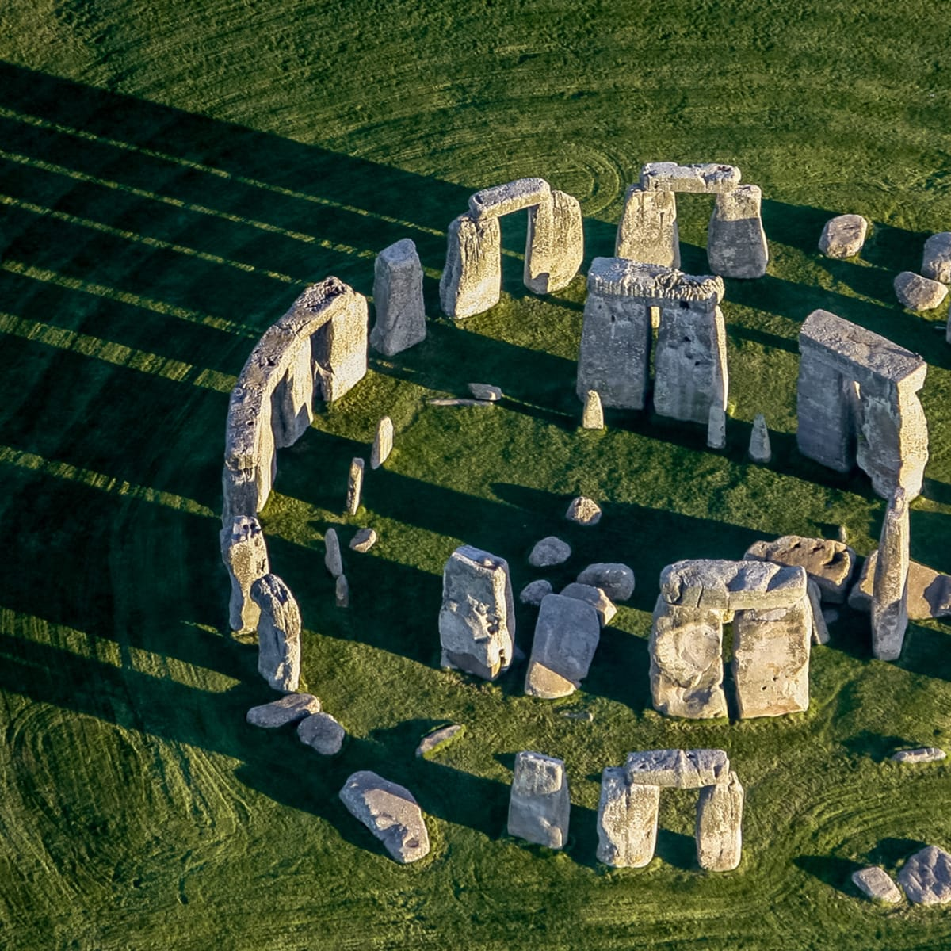
Stonehenge
The stones used to build Stonehenge were massive and heavy, and it's a mystery how the ancient Britons moved them and put them in place without modern tools or machinery.
Stonehenge was likely used for various purposes, including religious ceremonies, rituals, and marking important events like the changing seasons.
Some theories suggest that Stonehenge was a gathering place for the ancient Britons to come together for celebrations, ceremonies, and community events.
Stonehenge is a symbol of the ingenuity and craftsmanship of the ancient Britons, and it continues to be a source of wonder and fascination for people around the world.

Slide 9
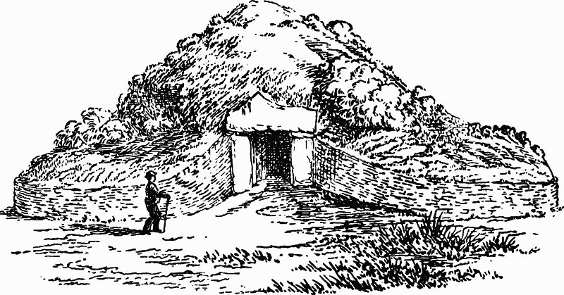
Weapons of Palæolithic manwere rough.
Palæolithic man even began to build huts and to scratch pictures on the sides of the caves.
British History

Slide 10
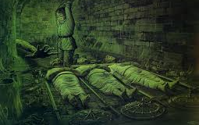
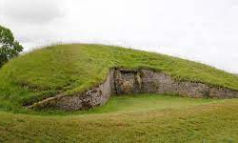
Barrows
They started to create communal burial barrows for the following reasons:
Social and Cultural Practices
To stop the chalk upland soil getting poorer
Beliefs about afterlife
Resource management
Symbolism and Status
Community cohesion

Slide 11
The Bronze Age
It is guessed the period lasted for 3500 (41 BC – 6 BC) years and ended.
The inhabitants of Britain were still quite savage at a time (about 2000 years before Christ).

Slide 12
THE BEAKER PEOPLE
They migrated and settled in the region.
They are named after their distinctive pottery vessels, known as Beakers, which were often buried with the deceased. These people are associated with the construction of burial barrows, which were prominent features of their burial practices.
Farmers and archers
The Beaker People crafted their own pottery and eventually introduced weaving to Britain, along with a honey-based mead, marking the first known alcoholic beverage in the region. Unlike the communal orientation of the Neolithic era, the Beaker People established a patriarchal society, with individual warrior-chiefs or kings gaining prominence.

Slide 13
Trade in the Bronze Age
Traders came Britain to obtain tin in exchange for goods from their own lands.

Slide 14
The Iron Age and the Britons
Iron came relatively late to Britain compared to other parts of Europe.

Slide 15
Goidels and Brythons
England was invaded by a tribe called Goidels.
Then in the 5th BC a new tribe called Brythons came.

Slide 16
The Britons
The Britons lived in huts covered with mud and straw.
They were nearly all farmers.
They made their own clothes.

Slide 17
The Celts and the Iron Age
In the Iron Age, Britain came to be dominated by a group of people known as the Celts.

Slide 18
The Celts
They were tall, had fair or red hair and blue eyes.
They were technically advanced.
They knew how to work with iron
They controlled all the lowland areas of Britain.
They are ancestors of the people in Highland Scotland, Wales, Ireland, and Corwall today.
The Iberian people adapted to Celtic culture.
Anglo-Saxons or Anglo-Celts

Slide 19
Trade
Money began to be used.
The earliest link between Britain and the Mediterranean economy was the Cornish tin trade

Slide 20
The Coming of the Romans
The date of the first invasion of Britain by the Romans is 55 BC.
Julius Caesar had conquered Gaul in 58 and become proconsul of the province.

Slide 21
The Roman Conquest
In the year 43 AD. the Roman Emperor Claudius conquered Britain and make the Britons pay him taxes or tribute.

Slide 22
Julius Agricola (40–93)
Julius Agricola (40–93) was the governor of Britannia in the late 70s.
He spreads garrisons of Roman troops all over the country to keep it in order and gradually the headquarters of each garrison became a town.

Slide 23
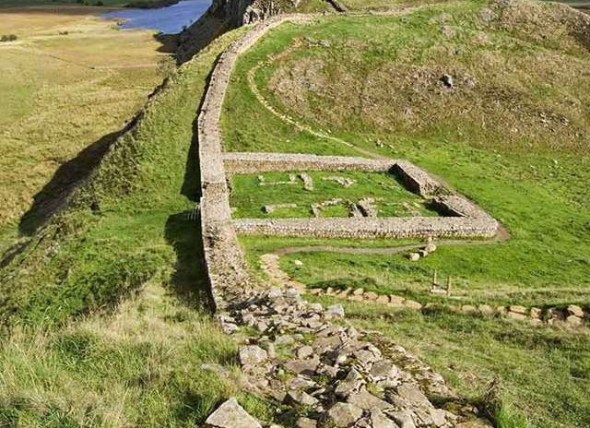
Hadrian’s Wall
English Heritage

Slide 24
The Roman Peace
All military arrangements kept Britons quiet and undisturbed by their enemies.

Slide 25
BIBLIOGRAPHY
Burns, William E. A Brief History of Great Britain. Facts on File, 2010.
Dance, E. H. Outlines of British Social History. Longmans, Green & Co., 1950.

